Slide 1

Period End Closing Execution (BSC)
Period End Closing Key Process Areas and New Period End Checks
Posting Period Control
Intercompany and Period End Closing
Lease Accounting and Period End Closing
Cost Management Closing Activities
Period End Closing for Accruals and Recurring Entries
Period End Data Checks
Asset Accounting Closing Activities
VAT Clearing and Reporting
GR/IR Closing Activities
Material Ledger Closing (Non-GSC Activities)
Automatic Clearing of LSC¹⁾ Accounts
G/L Closing Activities for Financial Statement Preparation
¹⁾ LSC – Accounts with indicator “Clearing Specific to Ledger Groups” active.

Slide 2
Period End Closing Key Process Areas and New Period End Checks
Branded WBS Settlement
Above Brand Contribution (ABC)
WBS Settlement / Allocation
Multi-brand WBS Settlement
Cost Management Closing Activities
Cost Center Distribution and Assessment
Custom Multi-brand WBS Allocation
Internal Order Settlement
(Leaf entities only)

Slide 3
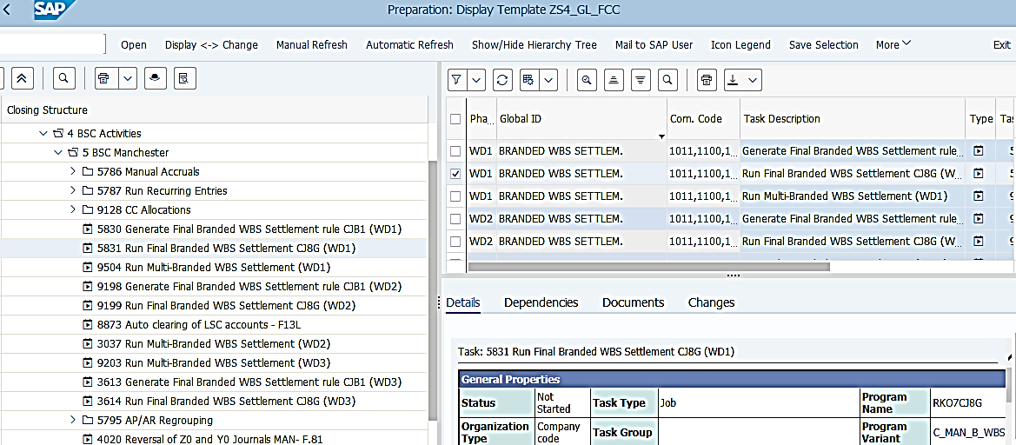
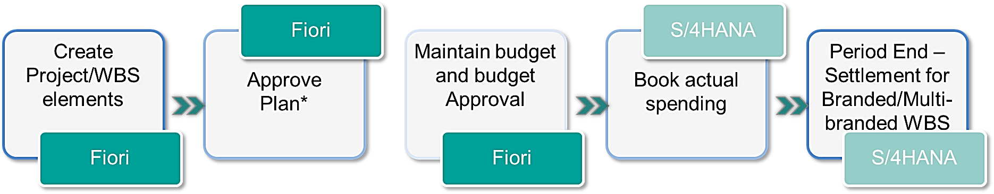

Above Brand Contribution (ABC) WBS Settlement / Allocation
Basic Above Brand Contribution WBS Process
JTI uses Opex WBS and ABC WBS for Cost Management purposes.
Opex WBS are statistical therefore no settlement is required.
There are Branded, Multi-brand and Statistical ABC WBS used in JTI. Only Branded and Multi-brand WBS require settlement/allocation to CO-PA characteristics at period end.
T-Code:
CJB1/CJ8G for Settlement
ZFFIR_POST_ALLOC_PS for Allocation
The settlement of ABC WBS is done following the same technical logic as Capex WBS (same T-Code CJ8G), but with different types of settlement receivers (Capex to Assets, ABC WBS to CO-PA).
Multi-brand WBS are mostly allocated (instead of settled) to CO-PA, using pre-defined allocation keys. However, if there is not a suitable pre-defined allocation key users can choose to create a custom settlement rule using custom allocation key ZZZ. Users will then need to create a settlement rule within that particular WBS in order to be able to settle costs.
FCC Task:
CJB1/CJ8G Settlement – GBS/JTBC Level
ZFFIR_POST_ALLOC_PS Allocation – Entity/GBS/JTBC Level
ABC WBS Settlement related transactions are scheduled at GBS/JTBC level. Multi-brand allocations are scheduled at entity level for GBS St. Pete and Warsaw due to the dependency to COGS and Inventory Splitting tasks for some entities in these GBS/JTBC. The Multi-brand allocation is scheduled at GBS/JTBC level for GBS Manila.
Timing: Branded: WD1,WD2, WD3, WD8
Multi-brand (Settlement-Allocation Key ZZZ): WD1, WD2, WD3
Multi-brand (Allocation- pre-defined Allocation key): WD2, WD3 (if requiring Material Ledger Closing result)
The final Branded WBS settlement for IFRS is done on WD3 before the final preparation of the financial statement. Most multi-brand WBS elements need to be settled/allocated on WD2 but a small portion which require COGS and Inventory splitting results for allocations are allocated on WD3.

Slide 4



Above Brand Contribution WBS Settlement / Allocation to CO-PA - Overview
JTI uses Opex WBS and ABC WBS for Cost Management purposes. Opex WBS are statistical therefore no settlement is required. There are Branded, Multi-brand and Statistical ABC WBS used in JT.
Only Branded and Multi-brand WBS require settlement/allocation to CO-PA characteristics at period end.
Multi-brand WBS elements
Branded WBS elements
Custom Multi-brand WBS elements
A multi-brand WBS element will be used to collect costs where brand and product type is unknown when the purchase order is created
On a monthly basis the custom WBS allocation program will be executed, and the costs will be allocated from the multi-brand WBS to brand family / product type CO-PA characteristics based on the weighting of year-to-date net revenue per brand family / product type for the market
Multi-brand WBS allocation to SKU will be possible for transportation / warehousing costs based on year-to-date net volumes
Each branded WBS element must be linked to a brand and product type – these are CO-PA characteristics
As expenses are recorded against the WBS element the brand family / product type will also be visible for reporting via instant derivation functionality
At month-end WBS settlement will be performed by BSC
4

Slide 5

Branded WBS Settlement - Overview
“Branded WBS Settlement” refers to the transfer of above brand contribution costs from branded WBS elements to Profitability Analysis (brand family and product type dimensions) via a settlement process.
Branded WBS Settlement allows for the removal of any balance on WBS elements by transferring those to Profitability analysis. This is possible as Brand Family and Product type information is available for such costs from the very beginning
Branded WBS Settlement occurs across all Ledgers
The result of Branded WBS settlement is the enrichment of respective P&L lines with Brand Family and Product type information allowing further analysis of brand/product type profitability
WD-1 Block GR Postings of G&A/Marketing
WD1: Stop booking AP invoices
WD1: Automatic settlement rules creation
WD1: Run of branded WBS settlements
WD3: Run of branded WBS settlements
WD2: Run of branded WBS settlements
WD3: Last submission of manual journals
GBS
JT BC
JT BC
JT BC
JT BC
Entity
JT BC

Slide 6
Multi- Branded WBS Settlement - Overview
“Multi-Branded WBS Settlement” refers to the transfer of above brand contribution costs from multi-branded WBS elements to Profitability Analysis (brand family and product type dimensions) via a settlement process.
Multi-Branded WBS Settlement occurs across all Ledgers
The result of Multi-Branded WBS settlement is the enrichment of respective P&L lines with Brand Family and Product type information allowing further analysis of brand/product type profitability
Multi-Branded WBS Settlement occurs across all Ledgers
The result of Multi-Branded WBS settlement is the enrichment of respective P&L lines with Brand Family and Product type information allowing further analysis of brand/product type profitability
WD-1 Block GR Postings of G&A/Marketing
WD1: Stop booking AP invoices
WD1: Run of multi-brand WBS settlements
WD2: Run of multi-brand WBS settlements
WD3: Run of multi-brand WBS settlements
WD3: Last submission of manual journals
GBS
JT BC
JT BC
JT BC
Entity
JT BC

Slide 7
Custom Multi- Branded WBS Allocation - Overview
“Custom Multi-Branded WBS Settlement” refers to the transfer of above brand contribution costs from multi-branded WBS elements to Profitability Analysis (brand family and product type dimensions) proportionally to the YTD net revenues or volumes
The result of Branded WBS settlement is the enrichment of respective P&L lines with Brand Family and Product type information allowing further analysis of brand/product type profitability
Ledger impact: IFRS
WD-1 Block GR Postings of G&A/Marketing
WD1: Stop booking AP invoices
WD2: Run of multi-brand WBS
WD3: Run of multi-brand WBS allocation
WD3: Last submission of manual journals
WD1: Close sales (accounts)
WD3: Confirmation of ML close
WD3: COGS split completion
GBS
JT BC
GBS
JT BC
Entity
GBS
GBS
JT BC

Slide 8
ABC WBS Settlement / Allocation Expected Results
Validations/Expected Results | Branded WBS | Multi-Branded WBS with allocation type ZZZ | Multi-Branded WBS
Debits and credits are within the same GL account netting to 0 | Yes | Yes | Yes
Separate documents in all Ledgers – 0L, ST, TX, where costs have been posted to WBS | 0L, ST, TX, where costs have been posted to WBS | 0L, ST, TX, where costs have been posted to WBS | IFRS only
The same profit center is debited and credited | Yes | Yes | Yes
The same cost center is debited and credited (if Cost center information is included in settlement rule) | Yes | Yes | Yes
The same functional area is debited and credited | Yes | Yes | Yes
Multiple settlement documents generated (if more than one currency used) | Yes | Yes | Yes
Document Type | SZ | SZ | XW

Slide 9


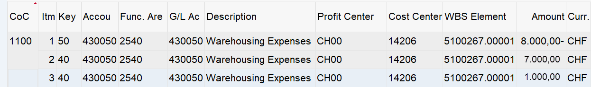
WBS Settlement / Allocation Actual Results Example
FB03L – Branded WBS Settlement
Debit and Credit in same:
G/L Account √
Functional Area √
Profit Center √
Balanced to zero √
Ledger other than 0L possible √
Document type SZ √
FB03L – Multi Branded WBS Settlement – Allocation ZZZ
Debit and Credit in same:
G/L Account √
Functional Area √
Profit Center √
Balanced to zero √
Ledger other than 0L possible √
Document type SZ √
FB03L – Multi Branded WBS Allocation
Debit and Credit in same:
G/L Account √
Functional Area √
Profit Center √
Balanced to zero √
Ledger other than 0L possible X
Document type XW √

Slide 10
Period End Closing Key Process Areas and New Period End Checks
Branded WBS Settlement
Above Brand Contribution (ABC)
WBS Settlement / Allocation
Multi-brand WBS Settlement
Cost Management Closing Activities
Cost Center Distribution and Assessment
Custom Multi-brand WBS Allocation
Internal Order Settlement (Leaf entities only)

Slide 11
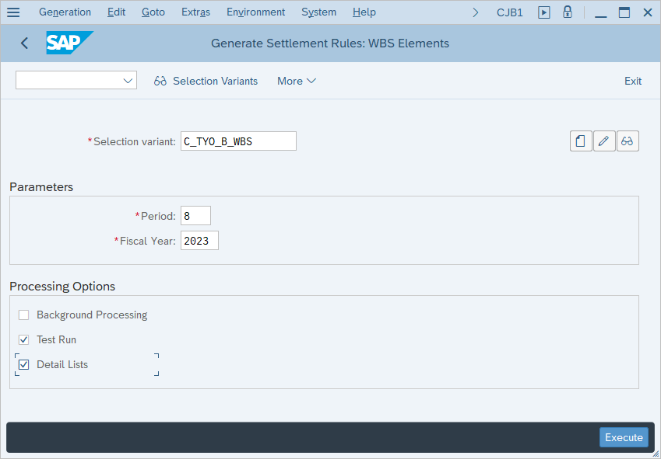
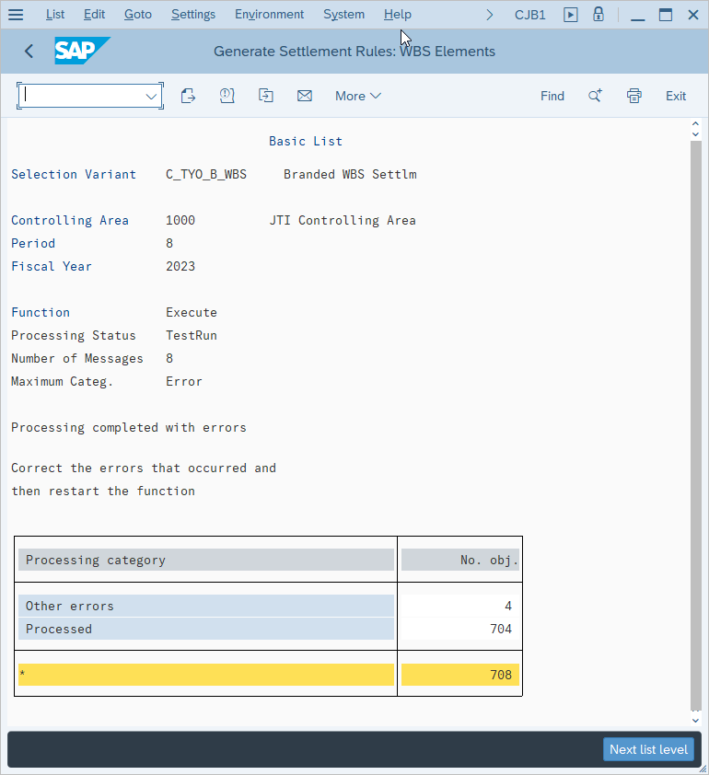
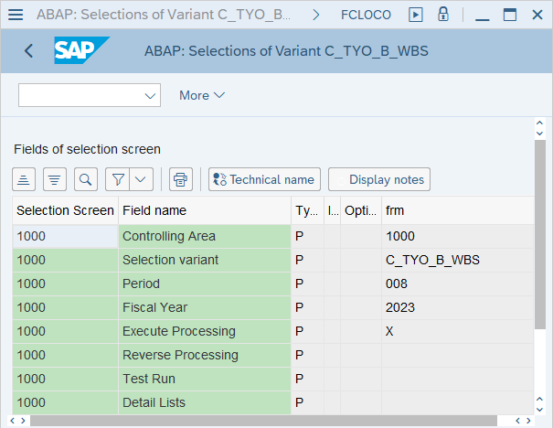
Branded WBS Settlement (CJB1 Generate Settlement Rules) (1/4)
This section provides instruction of how to execute the following T-Codes CJB1 and CJ8G
FCLOCO: FCC Task List -> Click on Variant of Branded WBS Settlement task
CJB1: Generate Settlement Rules: WBS Elements
Display messages icon will show more details on errors/warnings. Always check before proceeding
Branded WBS Generate Settlement Rules
If you execute CJB1 for Branded WBS outside of FCC, make sure you use the same selection variant as stated in the corresponding FCC task.
It is recommended that you do Test Run first, which can help you identify any errors before an update run, although Test Run is not mandatory and is not ticked in the FCC task variant.
If you have selected Detailed List, you will have a comprehensive log after your manual execution. Make sure you check messages in the log before deciding to proceed with update run (untick Test Run).
Next List Level will show what settlement rules have been processed

Slide 12
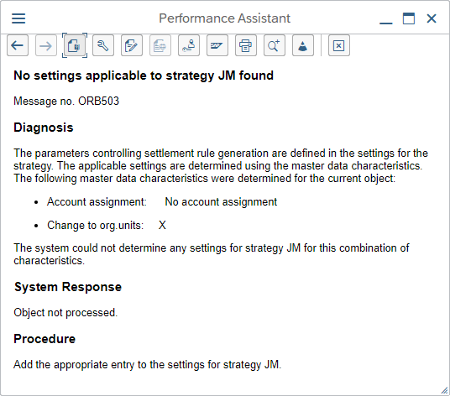
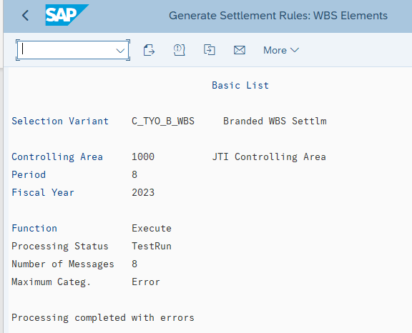
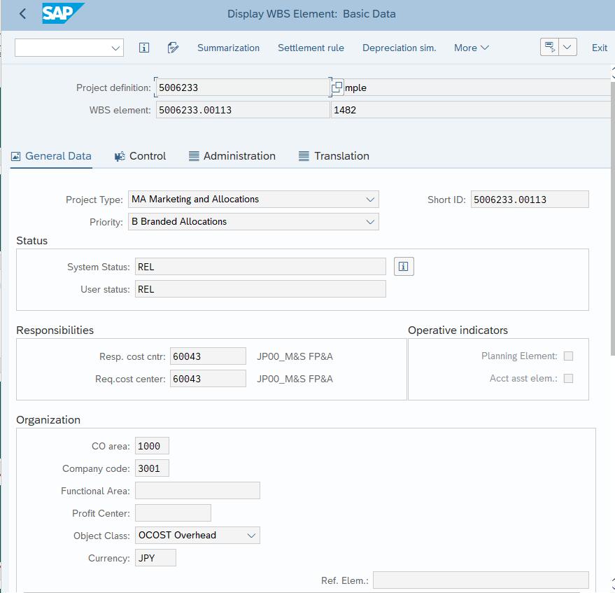
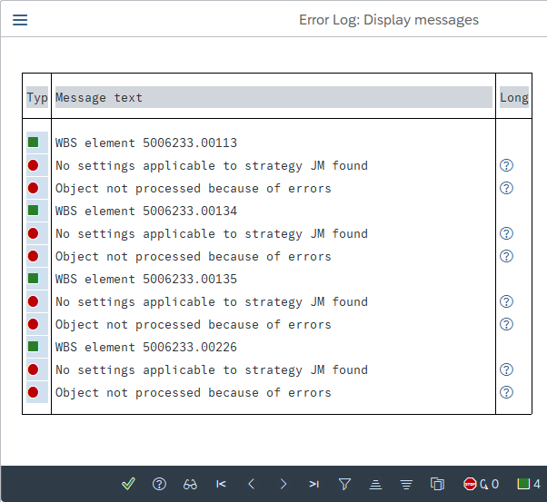
Branded WBS Settlement (CJB1 Generate Settlement Rules) (2/4)
CJB1: Generate Settlement Rules: WBS Elements
The system provides further information on errors and warnings to help resolve issues. Here is an example of a WBS having no account assignment
CJ13: Display WBS Element
Click the long text ? Icon to further understand error/warning messages
In CJ13 there is no account assignment for this WBS element, therefore settlement rules cannot be generated
Branded WBS Generate Settlement Rules
If you have selected Detailed List, you will have a comprehensive log after your manual execution. Make sure you check messages in the log before deciding to proceed with update run (untick Test Run).

Slide 13
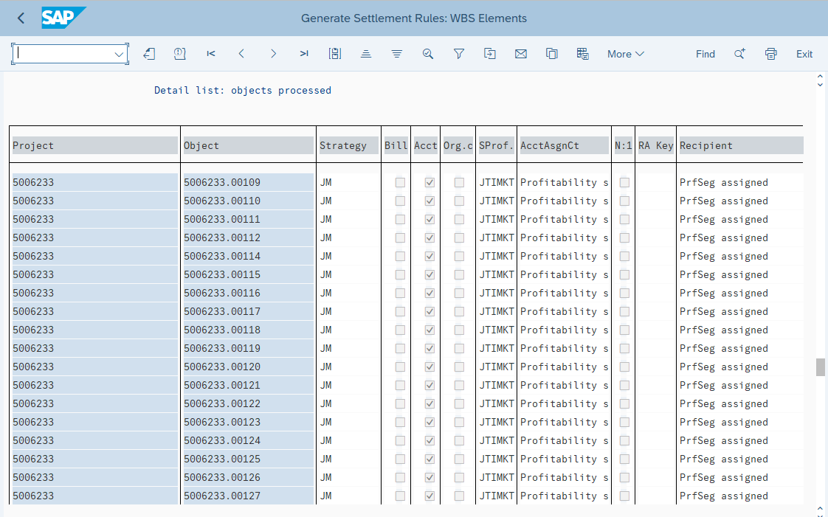
Branded WBS Settlement (CJB1 Generate Settlement Rules) (3/4)
CJB1: Generate Settlement Rules: WBS Elements
In the error on the previous slide WBS element 5006233.00113 was not processed as per the error message. Here we can see that WBS elements 5006233.00112 and 5006233.00114 have been process and the 00113 WBS is missing from the list
Next List level can be viewed by either clicking the icon highlighted or clicking on Next level list to give us the list of WBS elements that have been processed
Branded WBS Generate Settlement Rules
Next Level list shows all WBS elements that have successfully had settlement rules generated for.

Slide 14
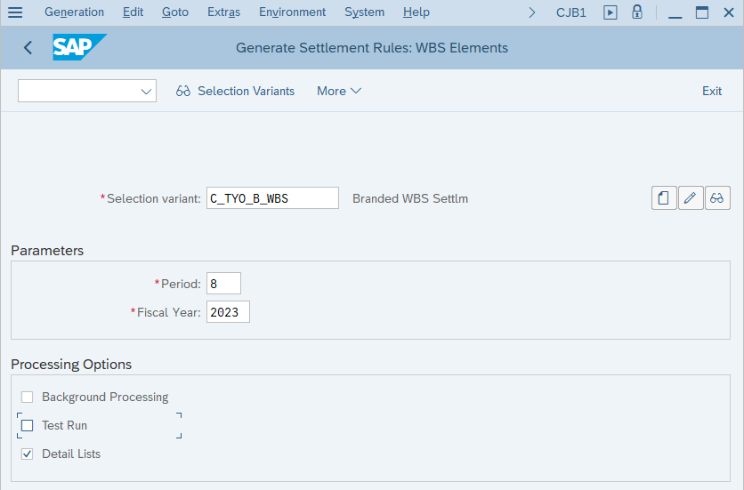
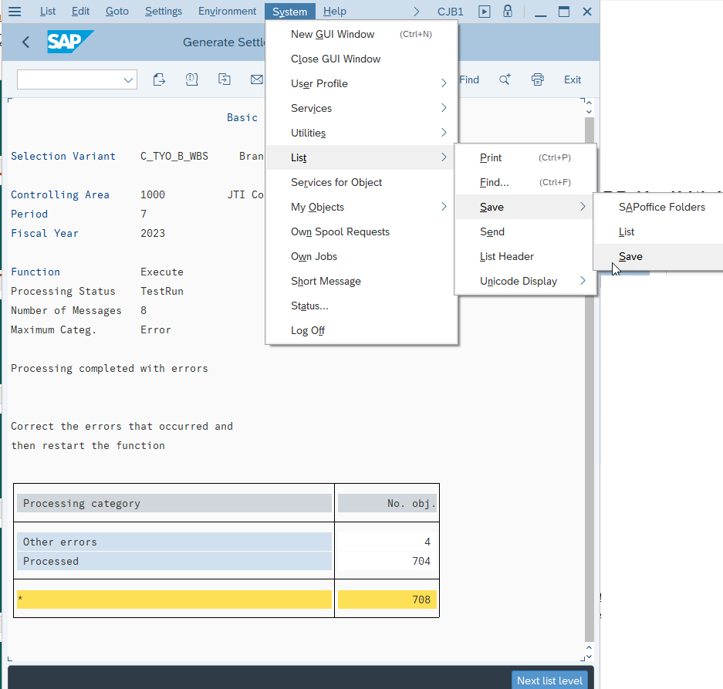
Branded WBS Settlement (CJB1 Generate Settlement Rules) (4/4)
Screen shot of parameters used
Screen shot of error log
Normally you should download the output log of any manual execution of a period end task for archiving purpose.
Follow the menu path: System->List->Save->Save and choose HTML format to save to the designated folder for your GBS/JTBC.
Branded WBS Generate Settlement Rules
All evidence of manual processing should be saved, same as generated in FCC: selection parameters, output log, spool list etc.

Slide 15
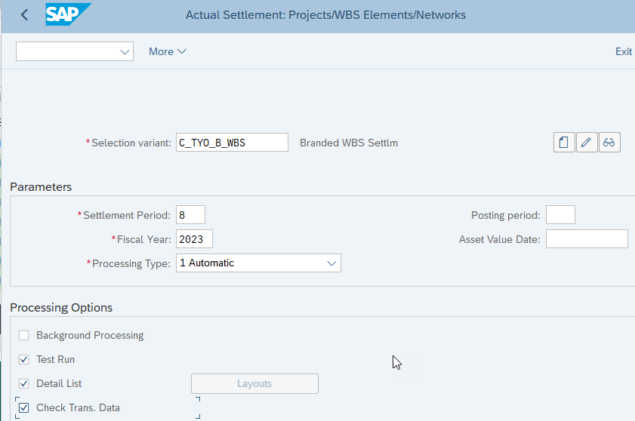
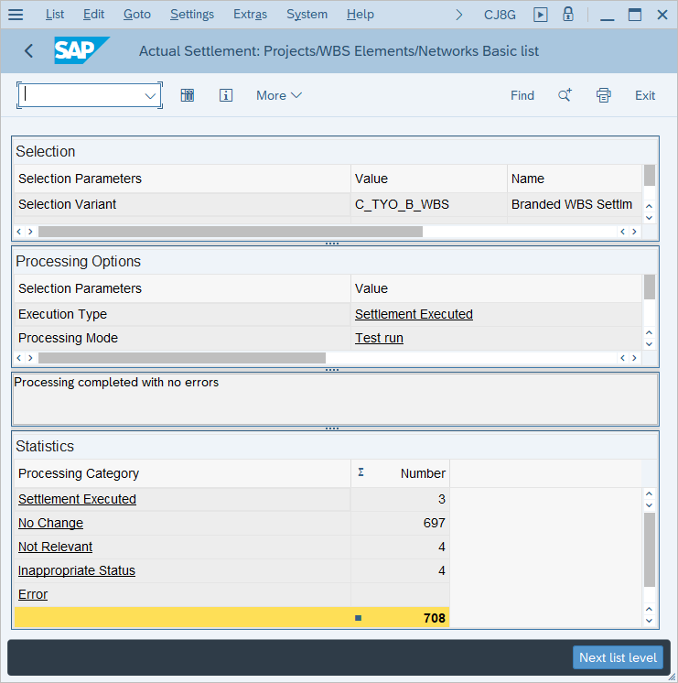
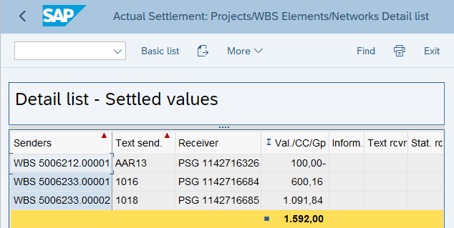
Branded WBS Settlement (CJ8G – WBS Settlement) (1/3)
FCLOCO: FCC Task List -> Click on Variant of Branded WBS Settlement task
CJ8G: WBS Settlement
Detailed list messages can be viewed by clicking the highlighted icon or clicking Next list level
Branded WBS Settlement - Execution:
If you execute CJ8G for Branded WBS outside of FCC, make sure 1) you have already run CJB1 to generated the settlement rules and 2) you use the same selection variant as stated in the corresponding FCC task.
It is recommended that you do Test Run first, which can help you identify any errors before an update run, although Test Run is not mandatory and is not ticked in the FCC task variant.
If you have selected Detailed List and check Trans.Data, you will have a comprehensive log after your manual execution. Make sure you check messages in the log before deciding to proceed with update run (untick Test Run).
Remember to screenshot the parameters used in the report for record keeping

Slide 16
Branded WBS Settlement (CJ8G – WBS Settlement) (2/3)
Settlement Executed
Number of senders that were
- Settled and for which a WIP calculation or results analysis has been carried out
- Settled only
For which only a WIP calculation or results analysis has been carried out
No Change
Number of senders for which there was nothing to settle in the settlement period per the settlement rule and for which no errors occurred.
Not Relevant
Number of senders that are not to be settled because
- The sender is statistical
- The settlement profile specifies that no actual costs are to be settled
- The sender is a WBS element that is not a planning element and planned settlement applies
- The settlement was started for a ledger, but the settlement sender is not configured for processing per ledger etc.

Slide 17
Branded WBS Settlement (CJ8G – WBS Settlement) (3/3)
In appropriate Status
Number of senders that are not to be settled because
- The sender still has status "Created"
- The sender has already been closed
- The sender is flagged for deletion (for performance reasons, these objects are excluded from processing, that is, the objects are not included in the number of messages)
- The sender has already been deleted (for performance reasons, these objects are excluded from processing, that is, the objects are not included in the number of messages)
- The sender is a production order that does not carry a results analysis key and neither technically completed nor delivered in the settlement period
The sender was settled using worklists and has a status that prohibits the settlement (for example, blocked)
Error
Number of senders for which at least one error occurred.
In online processing, use the "Messages" pushbutton to display the messages. In background jobs, the messages are listed in the spool list.

Slide 18
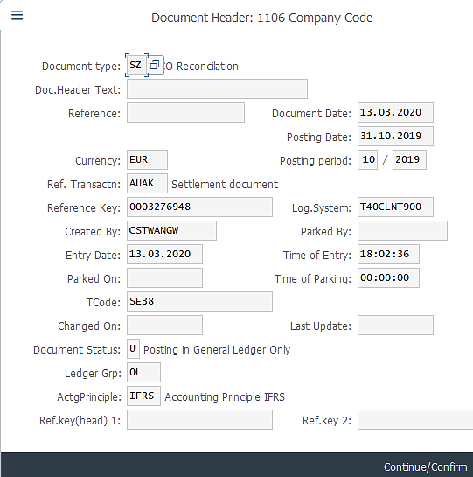
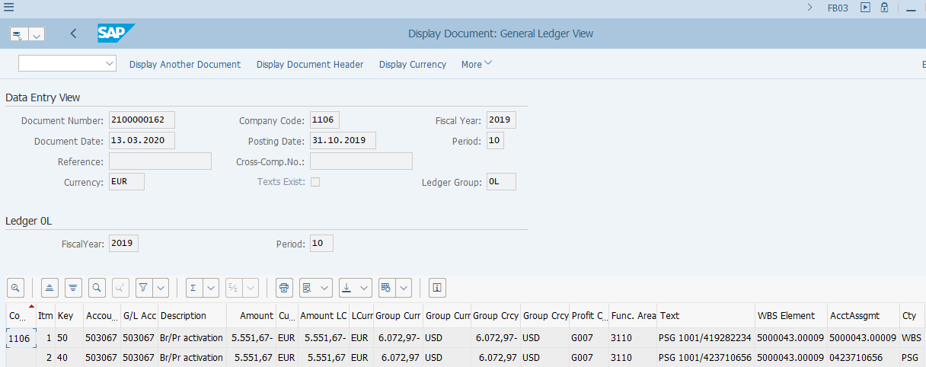
Branded WBS Settlement: Postings
FB03: Display FI Document
Branded WBS Settlement - Postings:
The Branded WBS settlement documents have the following features. You may search or filter for such line items on S/4 reports based on these features.
Same P&L account, amount, Profit Center, Functional Area, on both debit and credit side.
You will notice from the fields Account Assignment and Account Assignment Category, that the costs are moved from WBS to PSG (Profitability Segment).
Postings are made always with Document Type SZ
Postings are made in the corresponding ledger where costs were originally booked, therefore it can be in any ledger.
These documents do not have an Entry View so when you display them via FB03 or FB03L, you are taken to the Ledger View (as above) straight away.

Slide 19
Period End Closing Key Process Areas and New Period End Checks
Branded WBS Settlement
Above Brand Contribution (ABC)
WBS Settlement / Allocation
Multi-brand WBS Settlement
Cost Management Closing Activities
Cost Center Distribution and Assessment
Custom Multi-brand WBS Allocation
Internal Order Settlement (Leaf entities only)

Slide 20
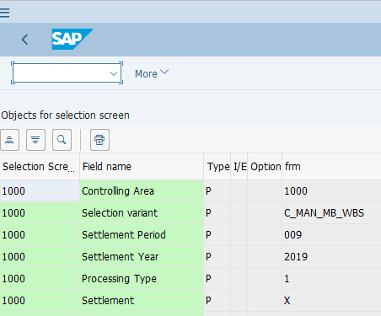
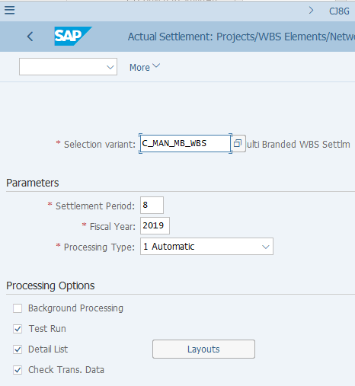
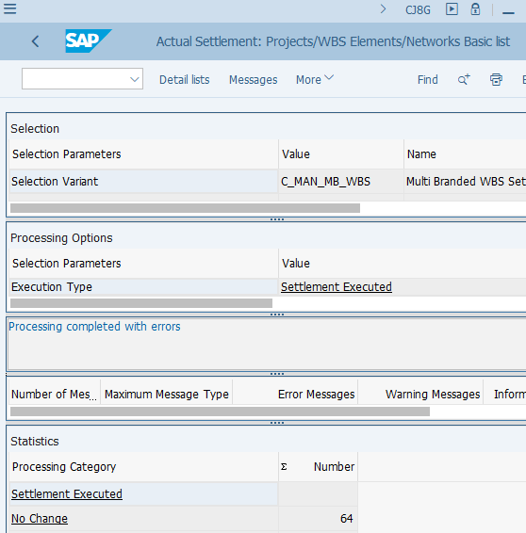
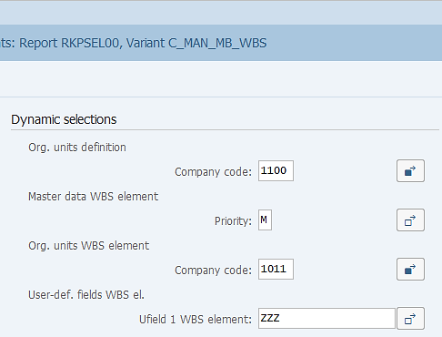
Multi-brand WBS Settlement: Execution (CJ8G) WBS with Allocation type ZZZ ¹⁾
Similar to the Selection Variant used in CJB1 and CJ8G for EAM WBS elements, the Branded and Multi-brand WBS settlement variants also use “GBS/JTBC Selection Variants”, in which the Company Codes are determined by the GBS/JTBC FCC folders via the Standard Variable for Company Code. Please follow the same instruction for EAM Selection variants to modify the Branded and Multi-brand WBS settlement Selection Variants if you need to execute them outside of FCC.
FCLOCO: FCC Task List -> Click on Variant of Branded WBS Settlement task
CJ8G: WBS Settlement
Multi-brand WBS Settlement – Execution via CJ8G:
If you execute CJ8G for Multi-branded WBS outside of FCC, make sure you use the same selection variant as stated in the corresponding FCC task. As you can see the selection variant is specific for Multi-brand WBS which have some important parameters.
It is recommended that you do Test Run first, which can help you identify any errors before an update run, although Test Run is not mandatory and is not ticked in the FCC task variant.
If you have selected Detailed List and check Trans.Data, you will have a comprehensive log after your manual execution, which lists the WBS elements that are settled with their corresponding senders and receivers.
Make sure you check messages in the log before deciding to proceed with update run (untick Test Run).
¹⁾ Please refer to Controlling WBS course materials for details of Multi-brand WBS with Allocation Key ZZZ.

Slide 21
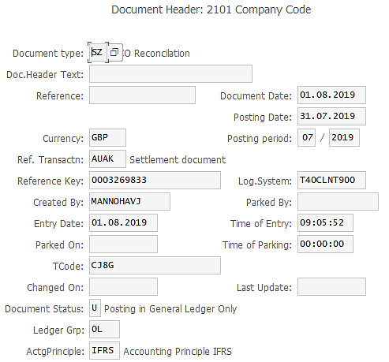
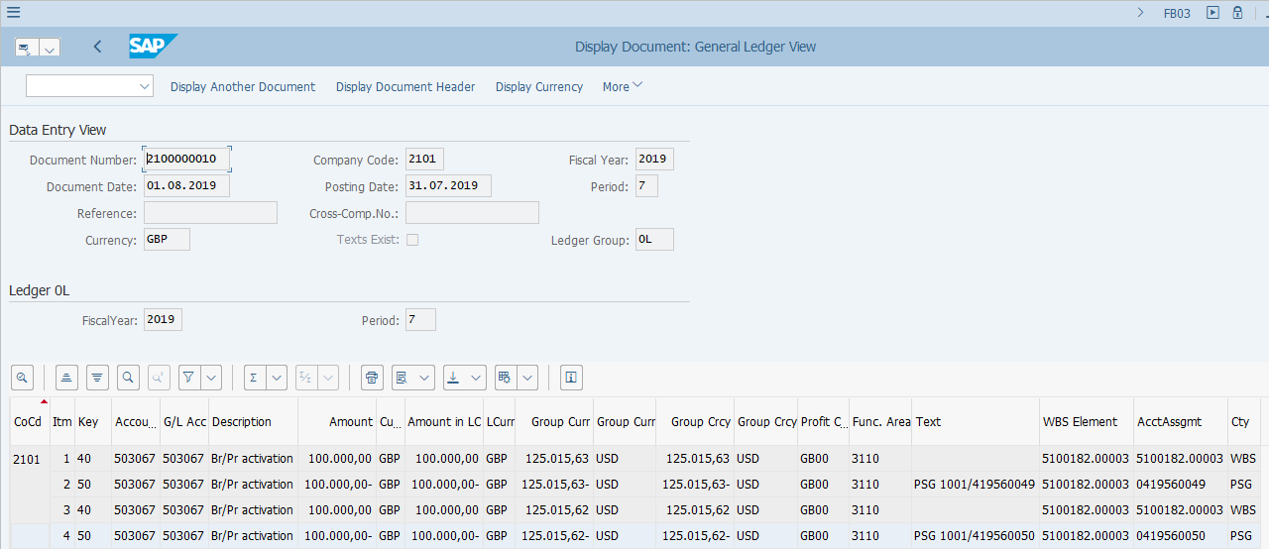
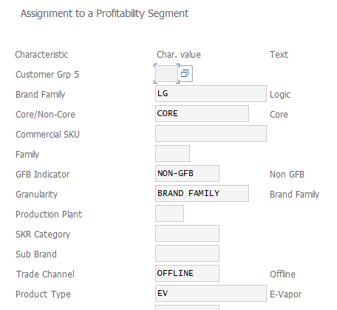
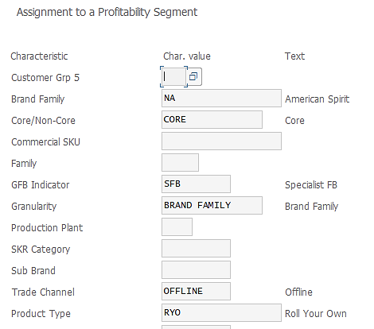
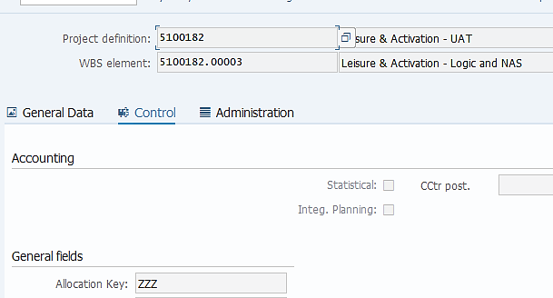
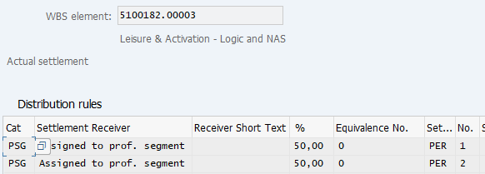
Multi-branded WBS Settlement: Postings (CJ8G) WBS with Allocation type ZZZ ¹⁾
FB03: Display FI Document
CJ13: Display WBS Element
CJ13: Display WBS Element -> Settlement rule
¹⁾ Please refer to Controlling WBS course materials for details of Multi-brand WBS with Allocation Key ZZZ.

Slide 22
Above Brand Contribution WBS Settlement – Common Errors
CJ8G Transaction Common Errors | Error Reason | Error Resolution
Project XXXXXX is currently being processed by XXXXXX. | It means that during settlement a user has the project open and therefore locked the project to settlement task. Settlement will not be executed for locked tasks. | GL Team should send an email to the respective user who is currently processing the Project to close this Project in SAP. Post receiving confirmation proceed to re-run FCC task or wait until next execution of the same task.
Maintain the settlement rule of the sender. | Some WBSs do not require settlement. For others that do require settlement, settlement rules should be maintained to correctly settle those WBS. | GL Team to inform Market that settlement rule maintenance is required. (NB: the settlement rule should be Full (not Periodic)) After Market update the Settlement rule, JTBC GL Team can re-run FCC task or wait until next execution of the same task and change the status to checked.
Predecessor Generate Final Branded WBS Settlement rule CJB1 (W of task Run Final Branded WBS Settlement CJ8G (WD1) has status 'In Process'; task Run Final Branded WBS Settlement CJ8G (WD1) cancelled | A predecessor step for the current task has status 'In Process', the predecessor step must have completed status before proceeding. | Re-run the task when the predecessor task has been completed and marked with green status.
System status **** is active (WBS...) | The WBS element from the message has status different than REL (Released). | If market has locked the WBS then it is ok to proceed - change the status to checked. Ask market to check WBS status if it has not been locked by them.
Check the closed period XXXX for variant 1000 and GL account XXXX | 1. GL COGS accounts closed earlier (WD1 18:00) than start time of WBS settlement (WD1 21:00). OR 2.Document posted in all ledgers after WBS settlement for IFRS on WD3. | 1. If the error appears on during tasks performed on WD1, WD2, or WD3 please check if the GL account has been closed prior to the WBS settlement run. If this is the case, please contact market to change the account. 2. If the error appears on WD5 during WBS settlement for STAT/TAX ledgers, it means GL document was posted after WBS settlement for IFRS ledger on WD3. No action is required and the document will be settled in the next period.

Slide 23
Period End Closing Key Process Areas and New Period End Checks
Branded WBS Settlement
Above Brand Contribution (ABC)
WBS Settlement / Allocation
Multi-brand WBS Settlement
Cost Management Closing Activities
Cost Center Distribution and Assessment
Custom Multi-brand WBS Allocation
Internal Order Settlement (Leaf entities only)

Slide 24
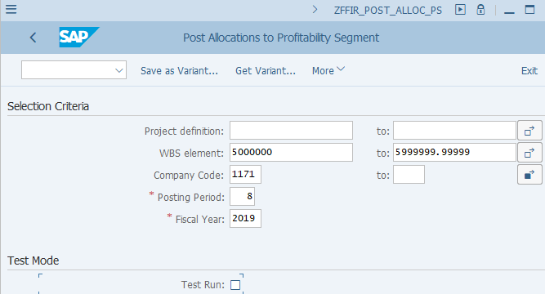
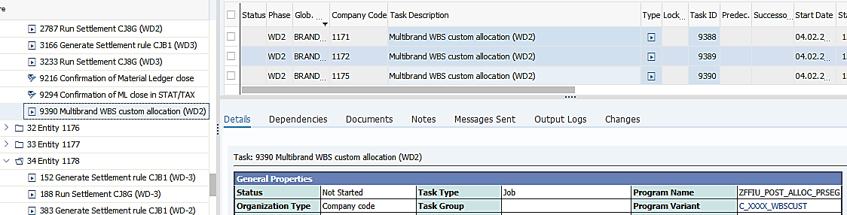
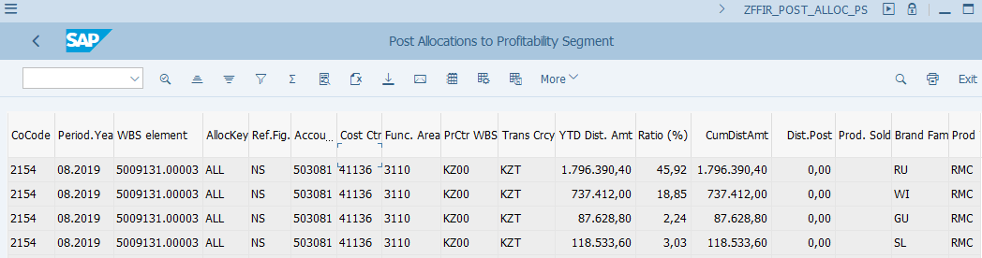
Custom Multi-branded WBS Allocation: Execution (ZFFIR_POST_ALLOC_PS)
FCLOCO: FCC Task List
Multi-brand WBS Allocation
– Execution via ZFFIR_POST_ALLOC_PS:
This task is scheduled at entity level for GBS Warsaw and St. Pete entities (due to dependencies), while at GBS/JTBC level for KL. Regardless of which level, the variants use the SAP standard variable for Company Code. This means you must review/amend the Company Code field when using it outside of FCC.
The automated program for multi-brand WBS allocations have features to determine how the costs should be allocated, and whether the allocation will impact SKU (plus all characteristics derived from SKU) or brand family and product type ¹⁾
This is an automated task in FCC. If you execute it outside of FCC you should use the same variant as stated in the FCC task. As the variant is using the standard variable for Company Code , you should always review/amend the Company Code field.
The output of the program shows the base of allocation, how much already distributed and how much should be distributed in the current period, as well as which product type and brand family are going to receive the distributed amounts.
Test run of this allows entity users to check if the calculation is done as expected before GBS/JTBC executes the transaction at period end.
¹⁾ Please refer to Controlling ABC WBS course materials for details of these features, how to execute the program and all the Allocation Keys.

Slide 25
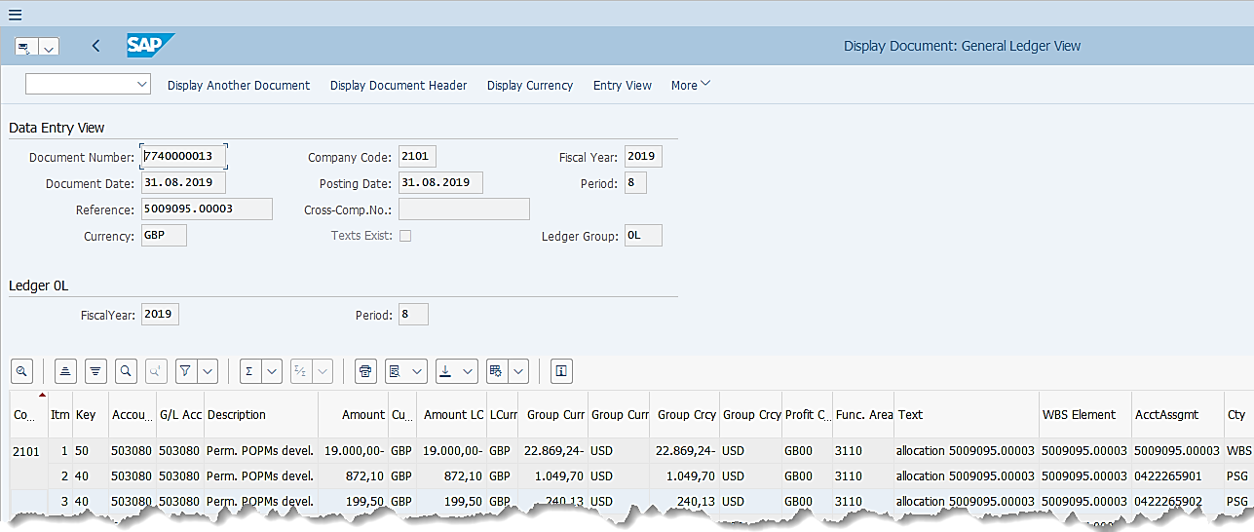
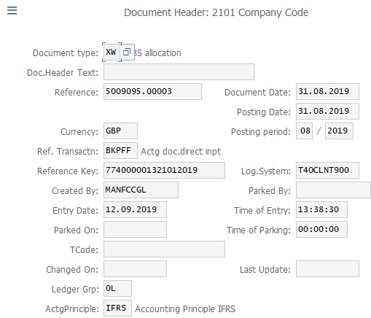
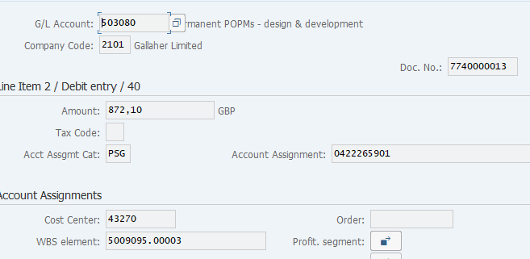
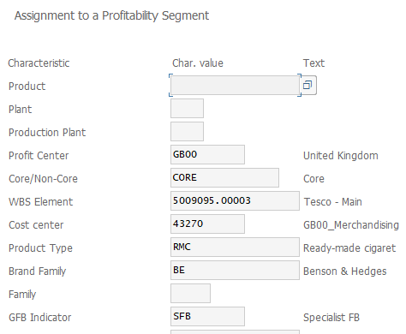
Custom Multi-branded WBS Allocation: Postings Type 1: WBS to PSG (Profitability Segment) (with brand family / product type / SKU populated)
FB03: Display FI Document
Multi-branded WBS Allocation – Postings – Type 1 WBS to PSG:
The Multi-branded WBS allocation for WBS to PSG allocation document have the following features. These are determined by the details maintained in the WBS element, which are explained in the Controlling ABC WBS course.
Same P&L account, amount, Profit Center, Functional Area, on both debit and credit side.
You will notice from the fields Account Assignment and Account Assignment Category, that the costs are moved from WBS to PSG (Profitability Segment).
Each line item posted to PSG contain different Product Type and Brand Family based on YTD net revenues/volumes.
Postings are made in IFRS ledger only.
Postings are made with Document Type XW.
These documents do not have an Entry View so when you display them via FB03 or FB03L, you are taken to the Ledger View (as above) straight away.

Slide 26
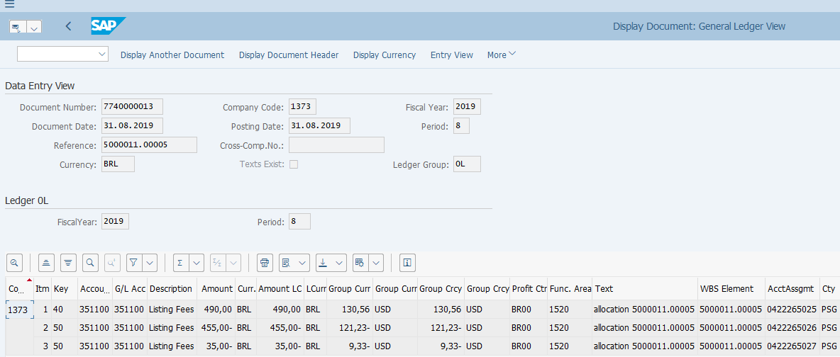
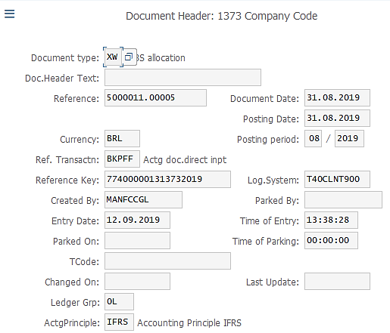
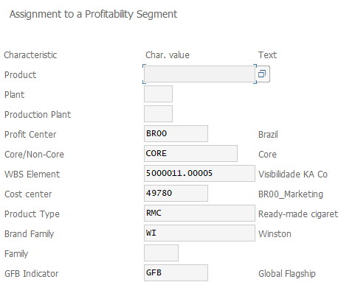
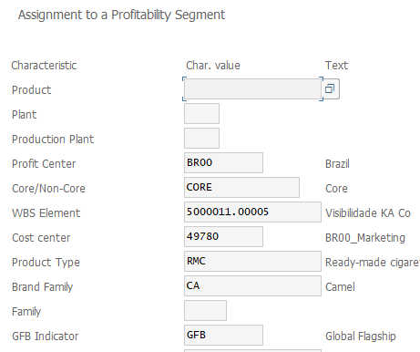
Custom Multi-brand WBS Allocation – Postings Type 2 – PSG (Profitability Segment) to PSG
FB03: Display FI Document
Multi-branded WBS Allocation– Postings – Type 2 PSG to PSG:
The Multi-brand WBS allocation for PSG to PSG allocation documents are generated in the cases when there are already costs allocated to Profitability Analysis from prior periods which should be redistributed based on the parameters of the WBS elements. These are explained in detail. in the Controlling ABC WBS course.
The Type 2 postings share the same features as Type 1 postings.

Slide 27
Custom Multi-brand WBS Allocation – Common Errors
ZFFIR_POST_ALLOC_PS Transaction Common Errors | Error Reason | Error Resolution
Error in document XXXXX. | Incorrect document type created | If the error log shows WBSs with error, GL Team should check if XW Document types are generated for these WBSs in T-Code FAGLL03 for the respective period. (e.g. 01.04.2023 to 30.04.2023). In order to run the report with document type criteria, user needs to use the dynamic selection function in FAGLL03, find the filter for Document type and enter XW. If XW Document types are not created for the WBS, WBS custom allocation was not executed for current period. In this case manual WBS custom allocation is required after issue resolution.
More than 999 receivers. Not possible to split doc with Cost center xxxxxx |  | Ask market to change the distribution rule.
Item XXX WBS element XXXXX budget exceeded |  | Ask market to increase the budget before the next run.
Inconsistency between a document field and the prof. segment number | There are inconsistencies between Cost Center assigned to WBS and Cost Center posted in line with WBS (incorrect booking) | Please inform the market and the person who requested the booking, that the document was booked incorrectly and should be reversed. An appropriate Cost Center, consistent with that used in the master data of the WBS, should be used.

